Slide 1
Get Access to your Online Course Tools
Course: Econ 3040 – Intermediate Macro
Instructor: Steven Kyle
Office: 437 Warren Hall
Hours: Tue/Thu 12 – 1PM
Email: sck5@cornell.edu

Slide 2
REQUIRED COURSE MATERIALS
1) text:
2) online resources:
REQUIRED TO COMPLETE YOUR ASSIGNMENTS

Slide 3
ECONPORTAL INCLUDES…
e-Book
Homework
Study tools

Slide 4
ACTIVATION CODE
Alert! Do not throw away your access card until you’re registered!

Slide 5
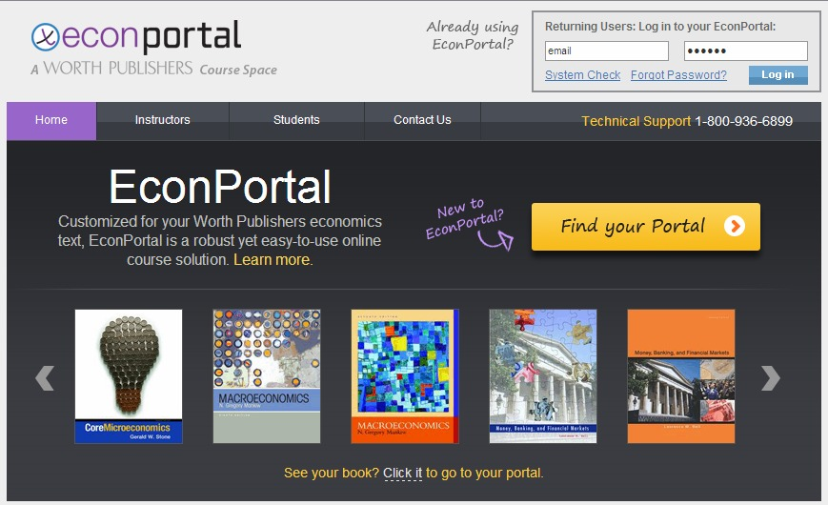
REGISTER ACTIVATION CODE
Go to www.youreconportal.com
2. Click on “Find your Portal”

Slide 6
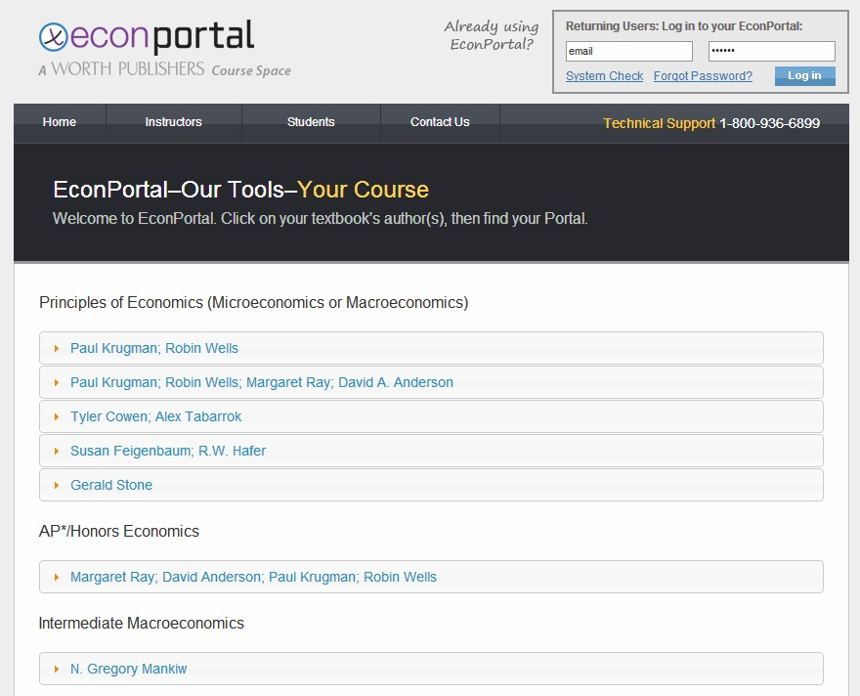
Find your version
2. Scroll down to find your book author. Click on “N. Gregory Mankiw”.

Slide 7
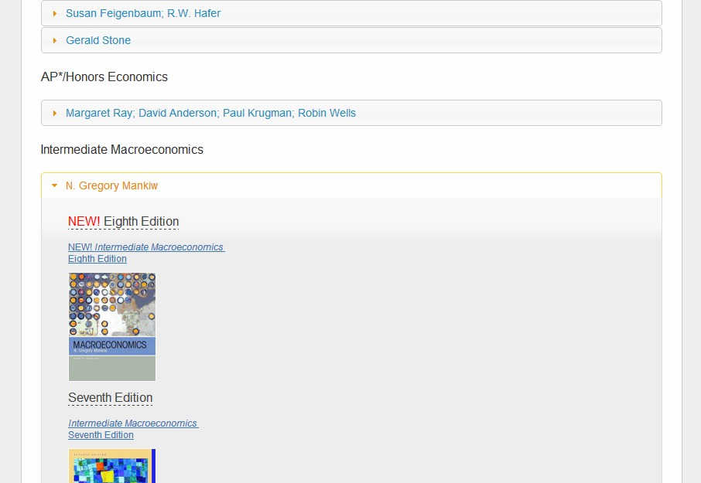
Find your version cont.
3. Find “Intermediate Macroeconomics, Eighth Edition” and click on the link.

Slide 8
Register your code
4. Click on “REGISTER an Activation Code”

Slide 9
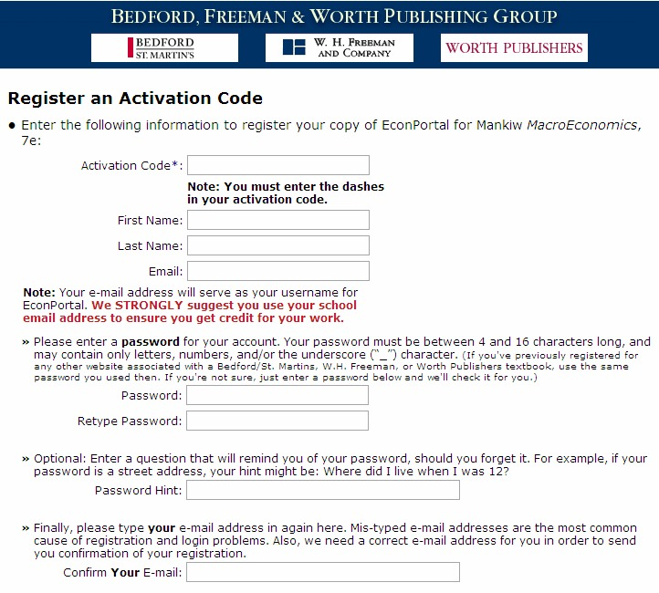
Create your login info
The activation code is printed inside your access card.
Access card

Slide 10
Register into the proper course
State
School
Instructor / Section
Select
Any difficulties call Tech Support at 1-800-936-6899

Slide 11
Once you confirm the info is correct, click “CREATE ACCOUNT”
You will receive an email confirmation that your registration was successful

Slide 12
http://courses.bfwpub.com/mankiw8.php
Check your computer for the necessary software

Slide 13
www.courses.bfwpub.com/bedguide9e
http://courses.bfwpub.com/mankiw8.php
Login to access:
Assignments
e-Book
Study Tools

Slide 14
RECOMMENDED BROWSERS
In Windows, we recommend that you use:
Current versions of Firefox
Current versions of Internet Explorer
In Mac OS, we recommend that you use:
Current versions of Firefox
Please note: Using Google Chrome or Safari is not recommended

Slide 15
Take out your phone
No, REALLY…take out your phone ☺
Put in the number for tech support:
1-800-936-6899
PLEASE NOTE: If you have any technical difficulties (registering, accessing, etc.) you must call tech support before you contact me. If you do need to contact me, you will need to include your
tech support TICKET NUMBER.

Slide 16
SUMMARY
Purchase Text + Activation Code
Register your Activation Code
System Check and Login
Call Tech Support w/any difficulties
Tech Support 1-800-936-6899

